Slide 1
Monopoly Power over Lialda®
ECON 503 28 Nov 2018
Yogesh Joshi
Xiaoyan Qian
Linlin Xu
Loretta Smith
© 2018. 4 authors listed above. All Rights Reserved.

Slide 2
Big Picture
Goal Monopolistic Behavior of Selling Patented Drug in U.S.
Firm / Drug SHIRE plc / LIALDA®
Lialda® vs Generics’ U.S. Entry
Lialda® Prices did NOT drop!
Detail Price Elasticity, Demand, and Supply
Price Discrimination U.S. vs Canadian Prices
Parting Thoughts ???Future of Patented Drug Monopolies in U.S.
2

Slide 3
Shire PLC: Big & Getting Bigger
Basics ONLY 30 years old, based in Ireland, NOW 23rd largest
Organization Headquarters = Decision-Maker of Drugs to Invest In
Rest of Company Distributed:
> 120 subs for differentiated activity
Biz Model Licenses R & D & Drug Manufacturing
No own R & D; Grows ONLY by Merger
ONLY NICHE drugs: NOT easily made OR competed against
THINK: Drug INVESTMENT Firm, NOT Drug Maker
Merger 2019: w/Takeda (biggest JP drug firm), THEN 8th largest
3

Slide 4
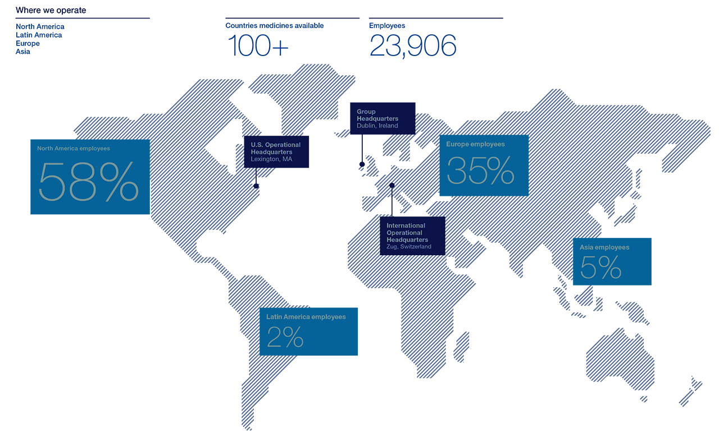
Shire Operations
4

Slide 5
Lialda® Monopoly in U.S.
Lialda® 2nd Best Selling of 27 Shire Drugs; = 10+ % of ALL Shire Sales
Shire’s Best-Selling Gastro-Intestinal (GI) Drug
Active Part Mesalamine (Aspirin-Like) in Patented Delayed-Release (DR) Layer
Treats Mild to Moderate Adult Ulcerative Colitis (“UC”)
FDA Uses Especially for UC Remission: 6 month USAGE
U.S. Market 700,000 have UC
MONOPOLY Arises from Patents, U.S. Drug Regulation & Drug Itself
Patents Licenses 27 Patents worldwide, incl. U.S. & Canada
Expires: 08 Jun 2020, Patentee: Cosmo Pharmaceuticals
U.S. Regulation ONLY U.S. script; ONLY FDA-approved use; ONLY as Lialda®
Drug Itself Delayed Release Layering: HARD TO COPY
5

Slide 6
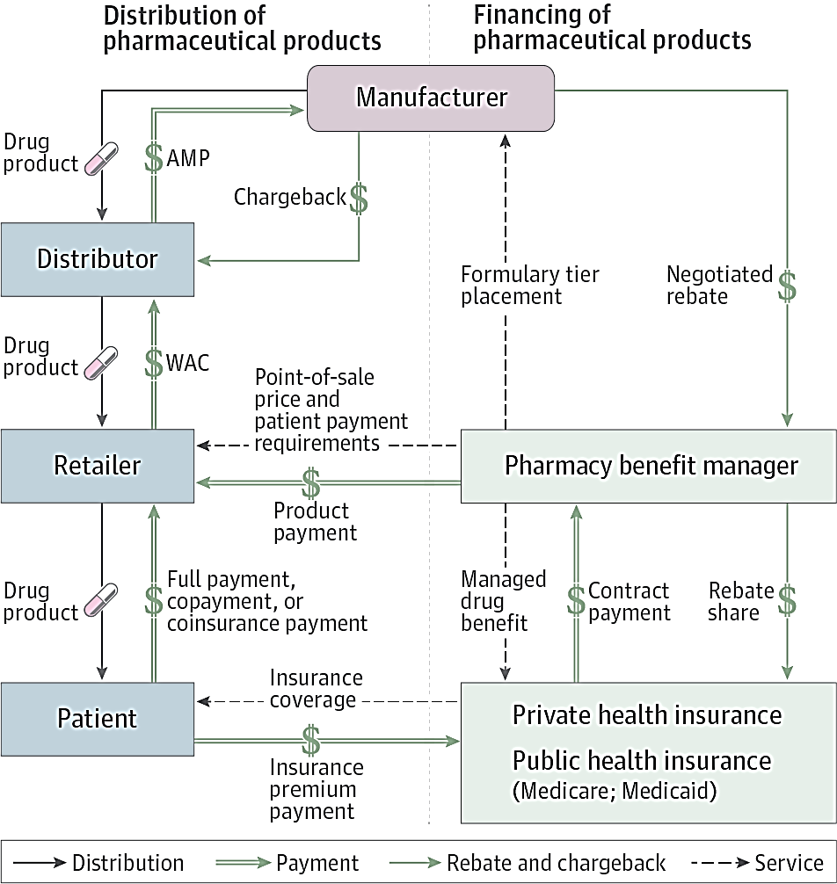
U.S. Drug Supply Chain
Cosmo = Patentee, Maker
6

Slide 7
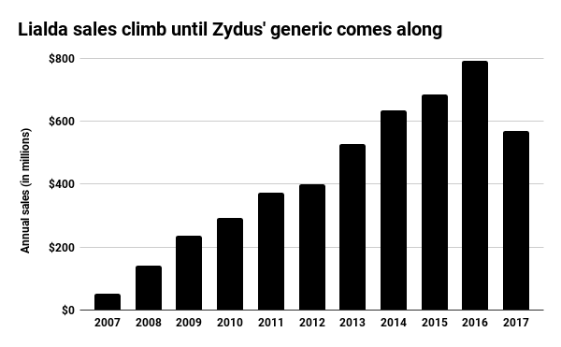
Lialda® Total & U.S. Sales (In Millions)
2015 |  | 2016 |  | 2017
Total | U.S. | Total | U.S. | Total | U.S.
684.4 | ~ 400 | 792.1 | 460 = 16 % Growth | 569.4 | 330 = 28 % Loss
7
Notes:
even if not generic, that’s a lot of loss.
drug generic, not a legal generic.
Shire has moved on to more lucrative drug areas.

Slide 8
Generics Did Not End Lialda® Monopoly
Litigation March 2017: Zydus & Teva products found Non-Infringing
NON-Infringing Means drug product not the same as Lialda®
Patent Monopoly NOT BROKEN: ONLY after 8 Jun 2020
FDA Approved NON-Infringing Products as Generic
Similar Enough to use LIALDA® Drug Testing
Generic Entry June 2017: Zydus (Indian generic firm) in U.S.
Mar 2018: Teva (biggest generic firm) entry in U.S.
Zydus U.S. Sales 2017 Q3 & 4: Reduced Shire Sales by 28%
Teva U.S. Sales 2018 Q1 & 2: Reduced Zydus Sales by 25%
8

Slide 9
U.S. Medicaid Prices Per Pill (in Dollars)
Bottom Line: Lialda® Prices Did NOT DROP After Generic Entry
9

Slide 10
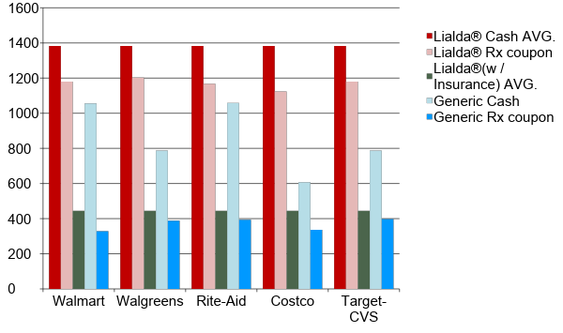
Average Price ($ /month): Lialda® vs Generic
10

Slide 11
Lialda® Price Elasticity
ELASTICITY | “a” (HIGHEST PRICE)
At Profit Max: MC = MR: hence MC = P ( 1 + 1/η ) η = P / ( MC - P) | P = a - b Q (-1 / b ) * (P / Q ) = η a = P + b Q
Assumption: mc = 220
(from lowest CA online price = $ 240)
 | η | A
P^{*1} = $ 1382.5 (Avg. U.S. Retail ) | η¹ = - 1.189 | a¹ = $ 2545.24
 | η¹ = 1382.5 / ( 220 - 1382.5 ) η¹ = - 1.189 | - b Q = P/η = - 1382.5 / 1.189 = 1162.74 a¹ = 1382.5 + 1162.74 = 2545.24
P^{*2} = $540 (Medicaid) | η² = - 1.6875 | a² = $ 860.00
 | η² = 540 / ( 220 - 540 ) η² = - 1.6975 | - b Q = P / η = - 540 / - 1.6875 = 320 a² = 540 + 320 = 860
Bottom Line: Markup = 250 to 500 % AND
Similar ηs at Different Ps => NO Price Discrimination in U.S. Market
11

Slide 12
Lialda® Demand (Medicaid Price: $9/pill X 60 pills = $540)
To Find Elasticity, Set MC = MR
η = P / (MC - P) = 540 / (220 - 540)
η = -1.6875, Elastic, Credible
a = 860
P *= 540
Find “a” (P, at Q = 0) from Q = a – b P
η = ( ΔQ / ΔP ) * ( P* / Q ) 1.6875 = - 1 / b * ( 540 / Q )
540 = a – b Q
540 = a – 320
a = 860
Q*
Profit-Maximized Price: $540 (SHIRE) vs $1382 (Avg. RETAIL)
12

Slide 13
Supply Curve
Perfectly Competitive | Monopolist
PRICE-TAKER | PRICE-MAKER
One of Many: Market Price | Sole Producer: Decides Price
Maximizes Profit, π, by:
Setting P = MR = MC Q determined by P | Setting MR = MC Q determined by MR & η
Bottom Line: NO SUPPLY CURVE for a MONOPOLIST
13

Slide 14
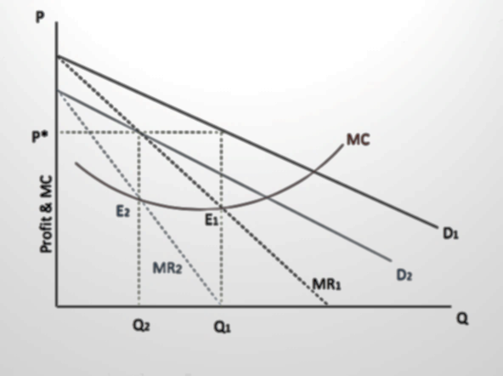
Our View of Lialda® “Supply Curve”
Shift in Lialda® demand
leads to
change in output
supplied at
the same price
14

Slide 15
Cross-Country Price Discrimination
SHIRE Markets SAME PILL under different Trademarks
Lialda® (U.S.) vs Mezavant® (Everywhere Else)
U.S. Doctors Prescribe Lialda® because Mezavant® Unavailable
SHIRE Sells SAME PILL for different price in U.S. vs in Canada
Avg. Monthly Price: $1382.50 (U.S.) vs $285.45 (Canada)
SHIRE Regulated in Canada by 3 separate gov’t agencies:
PMPRB (federal agency) sets “ex-factory” price based on “medical value”
17 federal, provincial public drug plans set price limits for their formularies
Common Drug Review, federal agency (like FDA), “proposes” prices limits
Bottom Line: X-Country Price Discrimination due to CA Price Regulation
15
Notes:
PMPRB - Federal Patented Medicine Prices Review Board
The PMPRB regulates the price at which patentees or their licensees sell patented medicines to wholesalers, hospitals or pharmacies – commonly referred to as the “factory gate” or “ex‐factory” price.
The drug price in U.S. is almost 5 times that in Canada!
Canada has publicly funded universal medicare system.

Slide 16
Parting Thoughts
PROBLEM: US drug prices = higher than anywhere else
SOLUTION: What to do? We differ on: Whether to Regulate Price or Not
ISSUES:
High R&D, sunk costs vs High US drug prices
Health care innovation vs Medically superfluous drugs
U.S. GDP helped by Big Pharma sales vs 15 - 20 % in U.S. can’t afford
PROPOSALS:
Limit drug patents to 10 years, BUT prices may spike more
Create US Drug Price Board, BUT Innovation may suffer
Apply Game Theory, to see if Trump makes credible threat
Encourage Self-Regulation, but will that really work?
What would you do?
16

Slide 17
NO Lialda® Substitutes (Xtra)
Determined by FDA Approved Treatment
Lialda® Shire
Treatment = 6 month remission of UC , NO other drug
Delzicol® Allergan: delayed release mesalamine,
Treatment: For acute, mild to moderate UC
Xeljanz® Pfizer: Antibody, Biologic, not a chemical
Treatment: rheumatoid arthritis, and GI inflammation

Slide 18
References 1
Slide 3, 5, and 6:
U.S. Securities and Exchange Commission, Form 10-K, Annual Report For Shire PLC For the Fiscal Year Ended December 31, 2017, Commission File Number 0-29630, found at http://investors.shire.com/~/media/Files/S/Shire-IR/documents/form-10k-annual-report-22-02-18.pdf
Slide 3:
Cosmo Pharmaceuticals 2017 Annual Report to Investors, 26 Mar 2018, found at
http://www.cosmopharmaceuticals.com/investor-relations/financial-reports

Slide 19
References 2
Slide 3:
Lisa Du and Aoife White, Takeda Heads to Shire Vote With Backing from EU, Advisory Groups, 20 Nov 2018, Bloomberg, found at https://www.bloomberg.com/news/articles/2018-09-23/takeda-shareholder-said-to-be-skeptical-on-shire-takeover
Ben Hirschler, 12 Nov 2018, Takeda sets vote date, aims to close $62 billion Shire deal Jan. 8, Reuters, found at https://www.reuters.com/article/us-takeda-pharma-shire/takeda-sets-vote-date-aims-to-close-62-billion-shire-deal-jan-8-idUSKCN1NH0RR
Mike Ward, A timeline of the Takeda-Shire merger, 2018, Pharma Intelligence, found at https://pharmaintelligence.informa.com/resources/product-content/a-timeline-of-the-takeda-shire-merger

Slide 20
References 3
Slide 5:
Villa et al., U. S. Patent Number 6,773,720, Mesalazine controlled release oral pharmaceutical compositions, issued 10 Aug 2004, found at https://patents.google.com/patent/US6773720B1/en?oq=US+6%2c773%2c720+
U.S. Patent and Trademark Office, Global Dossier for U. S. Patent Number 6,773,720, showing issued patents for Lialda®, found at https://globaldossier.uspto.gov/#/result/application/US/10009491/520358
Lialda®, U.S. Registered Mark Nos. 3415795 and 35554440, found at http://tmsearch.uspto.gov/bin/showfield?f=toc&state=4807%3A2l9py5.1.1&p_search=searchss&p_L=50&BackReference=&p_plural=yes&p_s_PARA1=&p_tagrepl%7E%3A=PARA1%24LD&expr=PARA1+AND+PARA2&p_s_PARA2=lialda&p_tagrepl%7E%3A=PARA2%24COMB&p_op_ALL=AND&a_default=search&a_search=Submit+Query&a_search=Submit+Query

Slide 21
References 4
Slide 5:
About Mesalamine and Lialda®
Generic Name: mesalamine; Brand Name: Lialda,® Last reviewed on RxList: 8/7/2017, found at https://www.rxlist.com/lialda-drug.htm
See also: https://www.rxlist.com/lialda-drug.htm#side_effects
https://www.webmd.com/drugs/2/drug-147055/lialda-oral/details
https://www.mayoclinic.org/drugs-supplements/mesalamine-oral-route/proper-use/drg-20064708

Slide 22
References 5
Slide 5:
Food and Drug Administration, Orange Book, Approval of Lialda®, Jan 2007 https://www.accessdata.fda.gov/scripts/cder/ob/results_product.cfm?Appl_Type=N&Appl_No=022000
Danese, Silvio, M.D., et al., 3 Nov 2011, Ulcerative Colitis, N Engl J Med 365:1713-1725.
Ulcerative Colitis Statistics, found at https://inflammatoryboweldisease.net/types-of-ibd/ulcerative-colitis/ulcerative-colitis-statistics/

Slide 23
References 6
Slide 8:
Traci Staton, 26 Feb 2015, Supreme Court pitches patent fight over Shire's Lialda after Teva ruling, Fierce Pharma, found at https://www.fiercepharma.com/legal/supreme-court-pitches-patent-fight-over-shire-s-lialda-after-teva-ruling
Shire Development LLC, et al. v. Watson Pharmaceuticals, Inc., 848 F.3d 981 (Fed Cir.2017)
Shire Development LLC, et al. v Cadila Healthcare Limited, dba Zydus Cadila, et al., No. 2017-1048 (Fed Cir.2017).

Slide 24
References 7
Slide 8:
_______ , 30 Apr 2012, Watson Pharmaceuticals: Acquisition of Actavis Creates a Lot of Value, Seeking Alpha, found at https://seekingalpha.com/article/541021-watson-pharmaceuticals-acquisition-of-actavis-creates-a-lot-of-value
Keith Speights, 11 May 2017, Actavis Generics Acquisition Drives Teva Pharmaceutical Industries Ltd. First-Quarter Sales Higher, The Motley Fool, found at https://www.fool.com/investing/2017/05/11/actavis-generics-acquisition-drives-teva-pharmaceu.aspx
Sohini Das, 8 Jun 2017, FDA nod for generic Lialda launch to boost US biz for Zydus Cadila in FY18, Business Standard, found at Appendix 1 here because article no longer free.

Slide 25
References 8
Slide 8:
Press Release, Cosmo Pharmaceuticals, 8 Jun 2017, FDA approves generic of Lialda®, found at https://www.cosmopharma.com/news-and-media/press-releases-and-company-news/2017/170608
Sohini Das, Zydus faces stiff competition for blockbuster drug in US from Teva Pharma, Business Standard, found at https://www.business-standard.com/article/companies/zydus-faces-stiff-competition-for-blockbuster-drug-in-us-from-teva-pharma-118033100689_1.html
_________, 26 March 2018, Teva Announces the Launch of a Generic Version of Lialda® in the United States, Business Wire found at https://www.businesswire.com/news/home/20180326006022/en

Slide 26
References 9
Slide 9: All Lialda® & Mesalamine Medicaid Prices
taken from Data.Medicaid.Gov found here https://data.medicaid.gov/Drug-Pricing-and-Payment/NADAC-National-Average-Drug-Acquisition-Cost-/a4y5-998d/data
Slide 10: U.S. Drug Price Research, found at https:///www.goodrx.com
Lialda not on 2018 or 2019 Express Scripts Formulary: https://www.express-scripts.com/art/pdf/Preferred_Drug_List_Exclusions2018.pdf
Slide 14:
Supriya Guru, Absence of Supply Curve under Monopoly, found at http://www.yourarticlelibrary.com/economics/supply-curve/absence-of-supply-curve-under-monopoly/37197

Slide 27
References 10
Slide 15:
Kristina M. L. Acri, July 2018, Implications of the proposed changes to Canada's pharmaceutical pricing regulations, found at https://www.fraserinstitute.org/studies/implications-of-the-proposed-changes-to-canadas-pharmaceutical-pricing-regulations
Joel Lexchin, 2015, Drug Pricing in Canada, Chapter 2, Pharmaceutical Prices in the 21st Century, ed. By U.-D. Babar, Springer International Publishing Switzerland.
_______ , Price Regulation of Patented Medicines in Canada, January 2009, PMPRB Presentation to the First Presentation to the First Pan-American Seminar on the Economic Regulation of Pharmaceuticals, found at https://slideplayer.com/slide/5773039/

Slide 28
References 11
Slide 15:
Wayne Critchley, Executive Director PMPRB, 27 January 2005, Drug Prices in the U.S. and Canada: More than Meets the Eye, National Academy of Social Insurance Annual Conference, found at https://slideplayer.com/slide/7529153/
Canadian Drug Price Research at https://www.pharmacychecker.com/online-pharmacy-ratings
Slide 16:
Trisha Torrey, (Reviewed by Richard N. Fogoros, MD), 8 Nov 2018, How to Buy Prescription Drugs from a Foreign Pharmacy, VeryWellHealth, found at
https://www.verywellhealth.com/how-to-buy-drugs-from-foreign-pharmacies-2614905

Slide 29
References 12
Slide 16:
Jon Greenwood, 29 Oct 2018, Trump’s Socialist Health-Care Scheme, Wall Street Journal, found at https://www.wsj.com/articles/trumps-socialist-health-care-scheme-1540852130
The Editorial Board, 28 Oct 2018, Why are Drugs Cheaper in Europe?, , Wall Street Journal found at https://www.wsj.com/articles/why-are-drugs-cheaper-in-europe-1540760855
Robert Pear, 20 Oct 2018, What Big Pharma Fears Most: A Trump Alliance with Democrats to Cut Drug Prices, New York Times, found at https://www.nytimes.com/2018/10/20/us/politics/trump-pharmaceutical-industry-healthcare.html

Slide 30
References 13
Slide 16:
The Editorial Board, 18 Oct 2018, Trump’s Drug Price Bust, Wall Street Journal found at https://www.wsj.com/articles/trumps-drug-price-bust-1539905098
Associated Press, 25 Sep 2018, Drug prices climb despite Trump promise, investigation finds, nbcnews.com, found at https://www.nbcnews.com/health/health-news/drug-prices-climb-despite-trump-promise-investigation-finds-n913011
________, 21 August 2018, Executive Summary: Prescription Pharmaceutical Price Changes since the Release of the President’s Drug Pricing Blueprint, U.S. Department of Health and Human Services, found at https://aspe.hhs.gov/pdf-report/data-point-prescription-pharmaceutical-price-changes-release-presidents-drug-pricing-blueprint. [trying to prove Trump’s threat of drug price regulation in the U.S. is causing drug companies to self-regulate and lower prices.]

Slide 31
References 14
Slide 16:
Sarah Kliff, 10 May 2018, The true story of America’s sky-high prescription drug prices, Vox, found at https://www.vox.com/science-and-health/2016/11/30/12945756/prescription-drug-prices-explained
Rebecca Robbins, 26 Mar 2018, A billionaire couple is pumping money into the drug pricing debate. Can they loosen pharma’s grip?, Stat News, found at https://www.statnews.com/2018/03/26/john-laura-arnold-drug-prices/
Editorial Staff, 29 February 2016, Chart Comparing Global Drug Prices Exposes How US Govt Creates Mega Profits for Big Pharma, Daily Health Post , found at https://dailyhealthpost.com/american-pay-on-average-2-6-times-more-for-lifesaving-drugs/

Slide 32
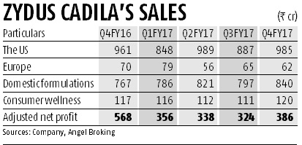
Appendix 1
Sohini Das, 8 Jun 2017, FDA nod for generic Lialda launch to boost US biz for Zydus Cadila in FY18, Business Standard, found here:
Ahmedabad-headquartered pharma major Zydus Cadila has got the final nod from the US drug regulator to market mesalamine tablets in the US. The ulcerative colitis drug is estimated to have a market size of $1.145 billion.
While most pharma majors are witnessing degrowth in the US, Zydus Cadila (or Cadila Healthcare) has managed to post a 2.5 per cent rise in its US revenues to Rs 985 crore during the fourth quarter of FY17. Analysts feel the launch of this blockbuster drug that has limited competition is will further boost its US business in FY18. Angel Broking estimated the company can add $60 million in sales and $20 million in net profit in the US market during the current financial year.
In fact, Zydus was the first to file an abbreviated new drug application (ANDA) for a generic version of Lialda (Mesalamine) in the US. In May, Zydus had said it had received a favourable judgment from a US federal court in a patent infringement case in favour of its US subsidiary, Zydus Pharmaceuticals (USA) Inc. The United States Court of Appeals for the Federal Circuit has affirmed the judgment in favour of its US subsidiary, Zydus Pharmaceuticals, holding that its proposed generic version of Lialda (Mesalamine) does not infringe US Patent No. 6,773,720. This basically paved the way for the launch of generic Lialda in the US.
Shire's Lialda treats ulcerative colitis, a form of irritable bowel disease that affects approximately 700,000 people in the US. In February, Shire had announced total sales of $792 million for Lialda in 2016, which had grown 16 per cent over last year. The generic version of Lialda, thus, presents a significant opportunity for Zydus in the US.
The US market contributes around 40 per cent to Zydus Cadila’s sales. According to Angel Broking, its overall revenue from the US market in FY17 was Rs 3,709 crore, or 40.22 per cent of its consolidated annual turnover of Rs 9,220 crore.

Slide 33
Appendix 2
From Cosmo 2017 Annual Report: COSMO’s Actual & Projected Revenue for Patented Mesalamine & No. of Pills Sold
 | 2015 Actual | 2016 Actual | 2017 Actual | 2018 Projected
Total Pills | 285,800,000
Total Mesalamine Revenue (in Euros & $) | E20,052,000 $22,733,920.61 | E22,205,000 $25,174,880.67 | E25,216,000 $28,588,596.76 | E19,014,000 $21,557,089.89 (24% loss of total sales from 2017)
US Lialda® Pills | 183,100,000 | 221,500,000 | 215,900,000 | 55,400,000
US Lialda® Revenue (in Euros & $) | E10,944,000 $12,407,741.23 (52% of Total Sales) | E13,299,000 $15,077,718.44 (60% of Total Sales) | E12,957,000 $14,689,976.53 (51.38%of Total Sales) Shows effect of Generic entry | E3,361,000 $3,810,527.99 (17% of Total Sales) (74% loss of US sales from 2017)
Q in US = No. of US takers of Lialda® | 183,100,000 / 360 = ~ 508,611 | 221,500,000 / 360 = ~ 615,278 | 215,900,000 / 360 = ~ 599,722 | 55,400,000 / 360 = ~ 153,888
Assumption 1: 30 day supply= 60 1.2g pills * 6 / months = 360 pills per year / per prescription (or Person)
Assumption 2: most Lialda® takers use for long-term remission,: they take for about 6 mos and then take a break
Assumption 3: Goodness of Fit of Calculations: Since there are about 700,000 US adults in U.S. with Ulcerative Colitis, the calculated numbers of 500,000 + may make sense

